Slide 1


DATA SCIENCE FINAL PROJECT
US SUPERSTORE
E-COMMERCE
ANALYSIS
Reporter: Nguyễn Phi Khanh
Audience: Marketing and Product Management Department

Slide 2
HOW TO IMPROVE SALES AND PROFIT OF SUPERSTORE ?
The importance of sales and profit:
Evaluate performance
Ensure operation
Increase value for shareholders
Attract investors
Create capital for reinvestment

Slide 3

TABLE OF CONTENTS
Data Overview
High Sales, Low Profit
Low Sales, High Profit
New and existing customers
Conclusion
Recommendation

Slide 4
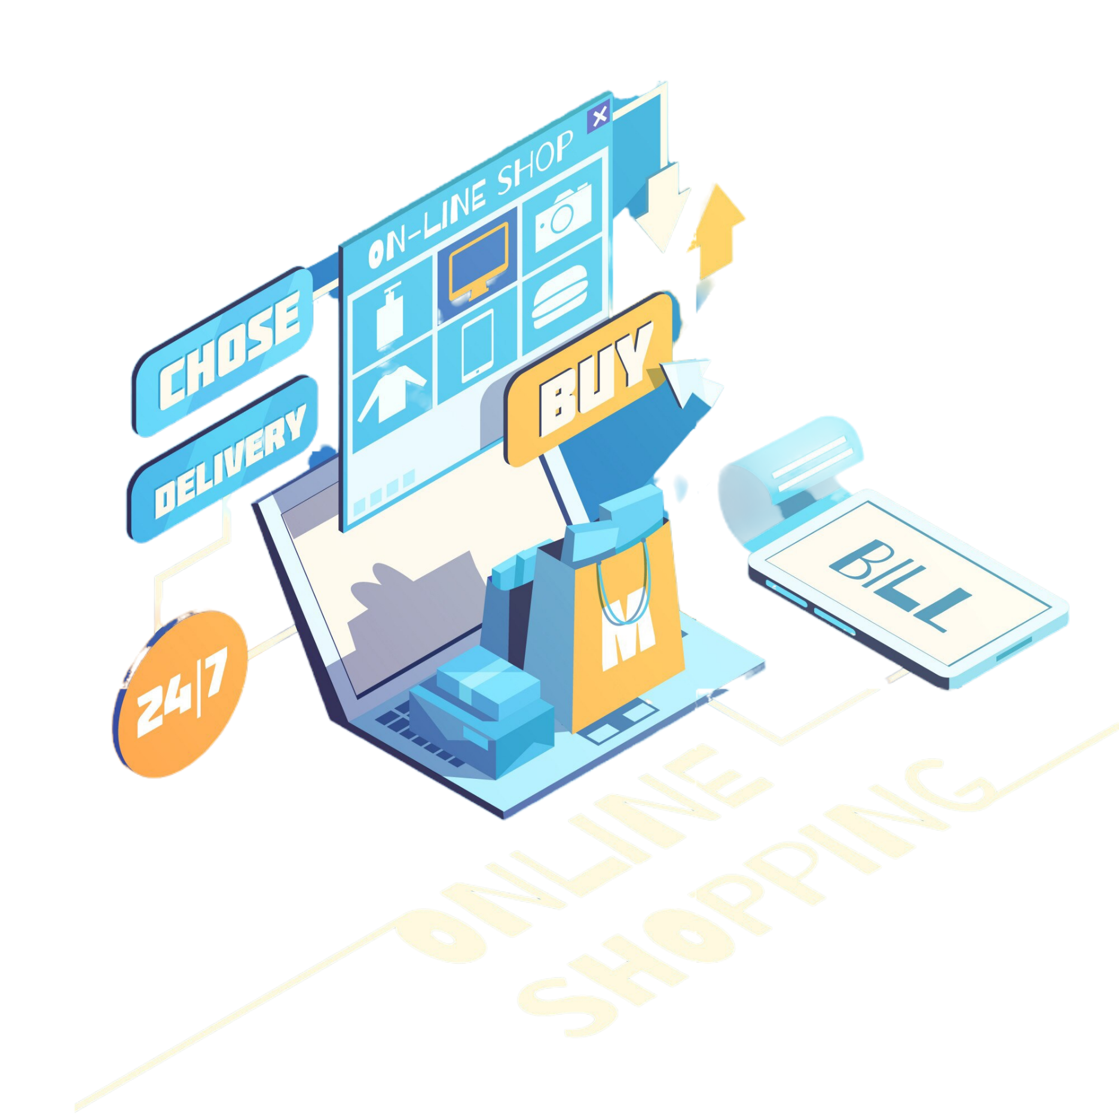
DATA OVERVIEW

Slide 5
DATA OVERVIEW
About 5,000 orders from 2020 to 2023 at Superstore in United States.
E-commerce platform allows people to buy products from paper, accessories, furniture, and other technology.
This dataset contains 21 columns and 10,372 rows.
The columns used are Order ID, Order Date, Customer ID, Segment, Sales, Profit, Discount, Category, Sub-Category and other calculated field

Slide 6
Products
DATA OVERVIEW
Product ID
Category
Sub-Category
Product Name
Orders
Row ID
Product ID
Order ID
Order Date
Ship Date
Ship Mode
Postal Code
Customer ID
Segment
Sales
Quantity
Profit
Discount
Location
Post Code
City
State
Region
Country
Customers
Customer ID
Customer Name

Slide 7
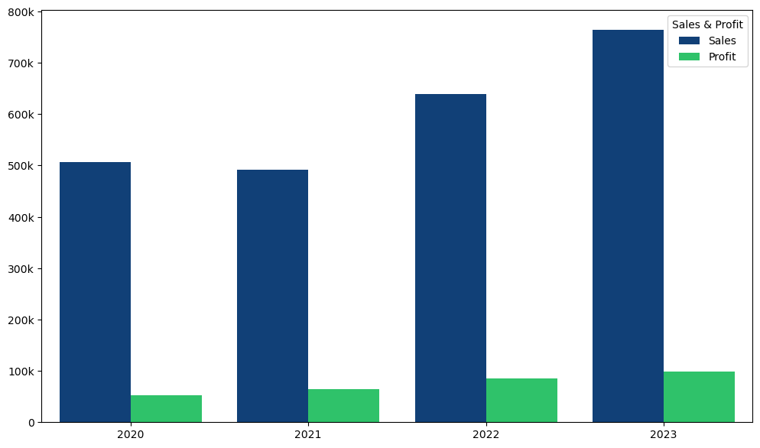
TOTAL SALES & PROFIT BY YEAR
Sales and profits increase gradually by year

Slide 8
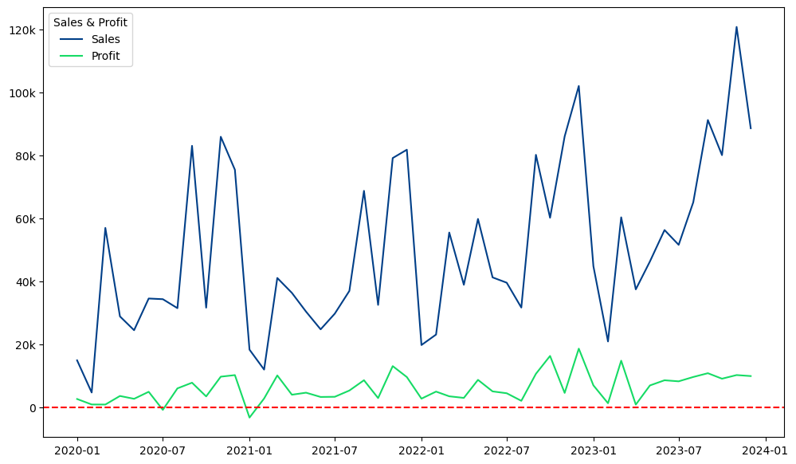
TOTAL SALES & PROFIT BY MONTH

Slide 9
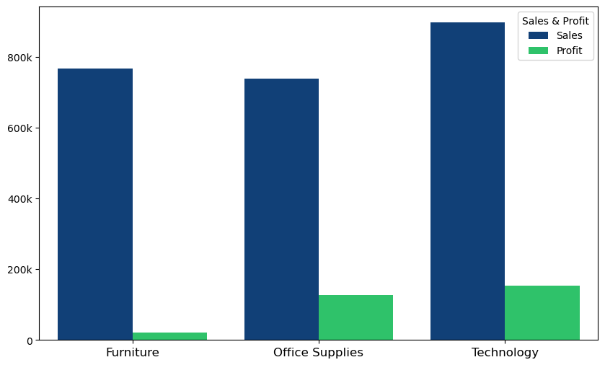
TOTAL SALES & PROFIT OF CATEGORY
The profit of Office Supplies is about 6 times larger than that the profit of Furniture and nearly equal to the profit of Technology
Furniture: High sales, low profit
Office Supplies: Low sales, high profit
Category

Slide 10
HIGH SALES, LOW PROFIT

Slide 11
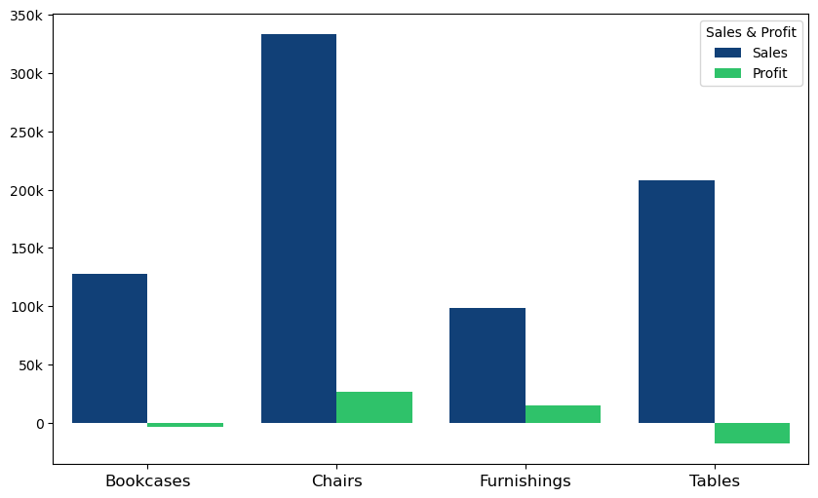
TOTAL SALES & PROFIT OF FURNITURE
The profit of Bookcases and Tables is negative
Sub-Category

Slide 12
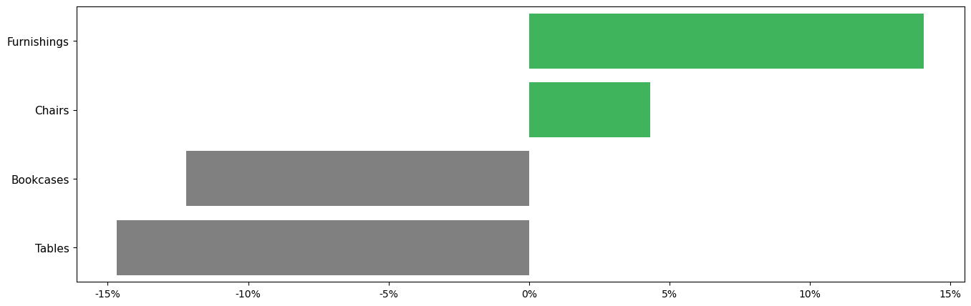
PROFIT RATE OF FURNITURE
(%) Profit Rate

Slide 13
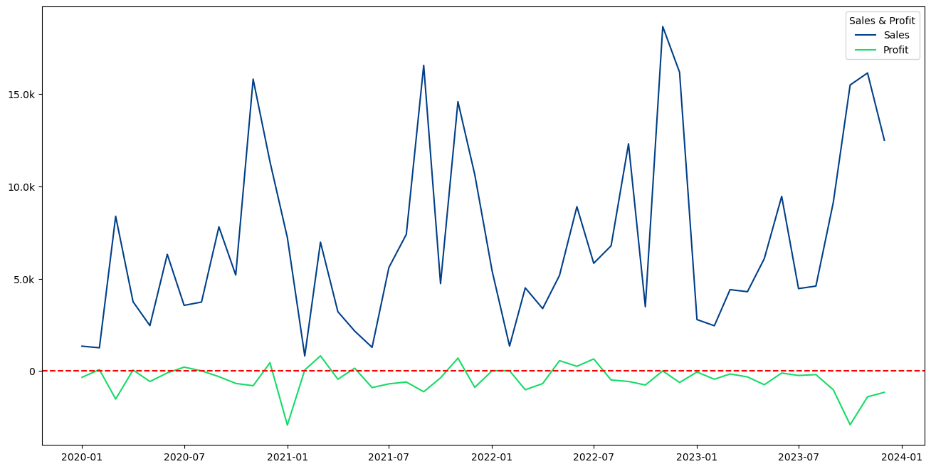
TOTAL SALES & PROFIT OF TABLES & BOOKCASES BY MONTH

Slide 14
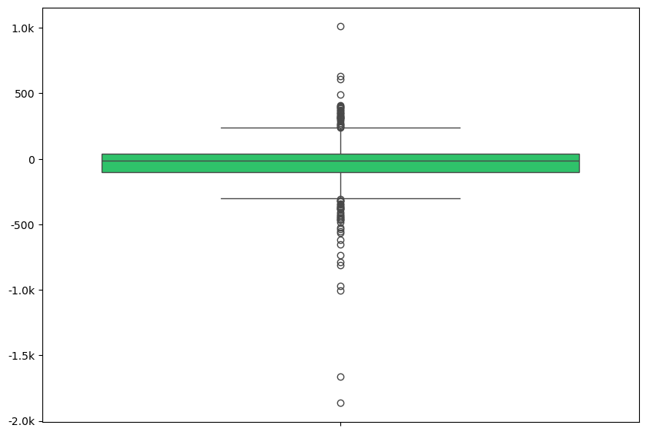
PROFIT DISTRIBUTION OF TABLES & BOOKCASES
High Profit
Outliers value below is 2 times above
Low Profit

Slide 15
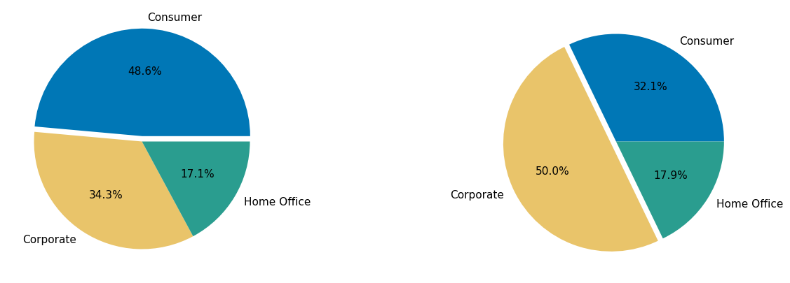
PROPORTIONS OF HIGH & LOW PROFIT ORDERS BY SEGMENT
LOW PROFIT
HIGH PROFIT

Slide 16
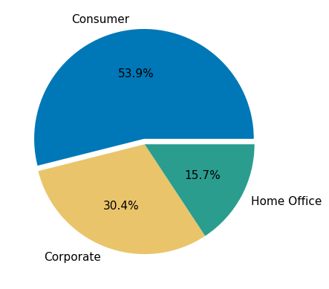

PROPORTIONS OF TABLES & BOOKCASES ORDERS BY SEGMENT
Customers are mainly consumers

Slide 17
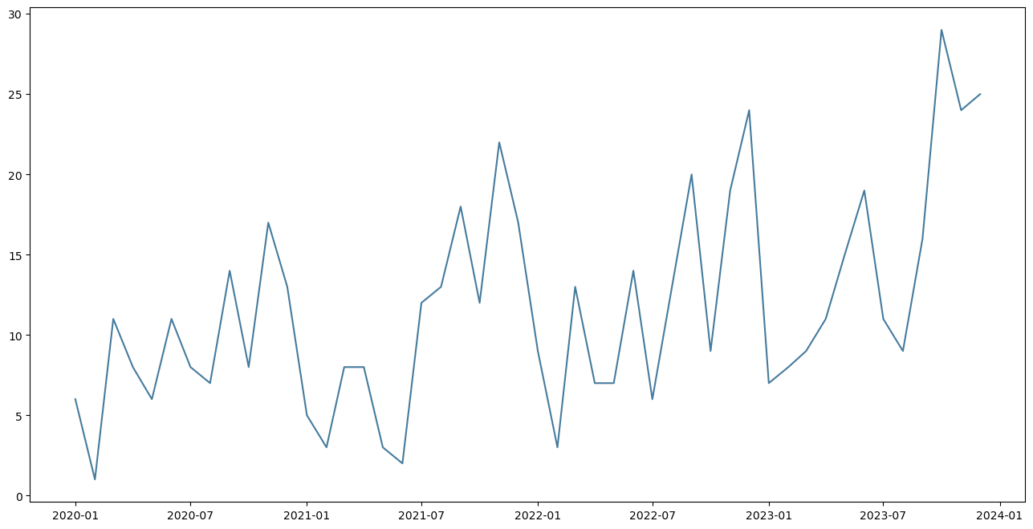
ORDERS OF TABLES & BOOKCASES BY MONTH

Slide 18
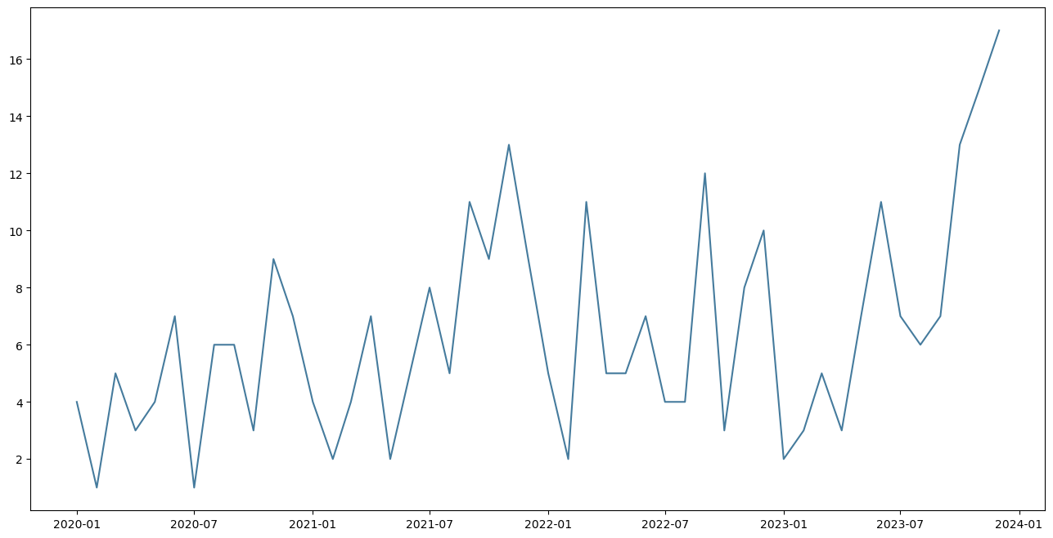
ORDERS OF TABLES & BOOKCASES BY CONSUMER BY MONTH

Slide 19

HIGH SALES, LOW PROFIT
The two products in Furniture are Tables and Bookcases that are not doing well and dragging down the profits of the Furniture category, as well as profits in January 2021.
RECOMMENDATION:
Superstore should change their customer segment.

Slide 20
LOW SALES, HIGH PROFIT

Slide 21
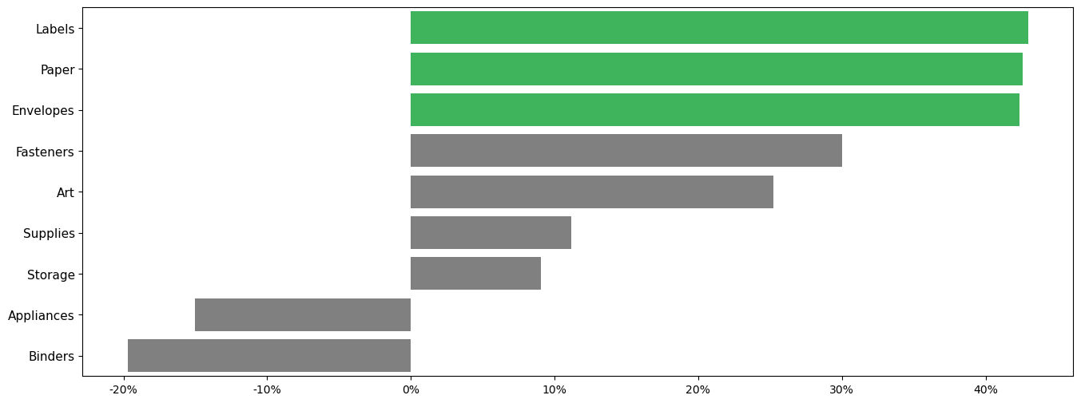
PROFIT RATE OF OFFICE SUPPLIES
(%) Profit Rate

Slide 22
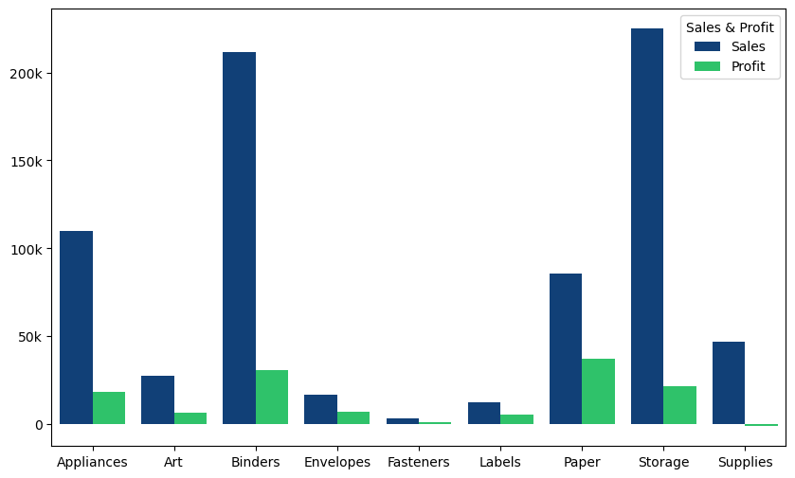
TOTAL SALES AND PROFIT OF OFFICE SUPPLIES
Sub-Category

Slide 23
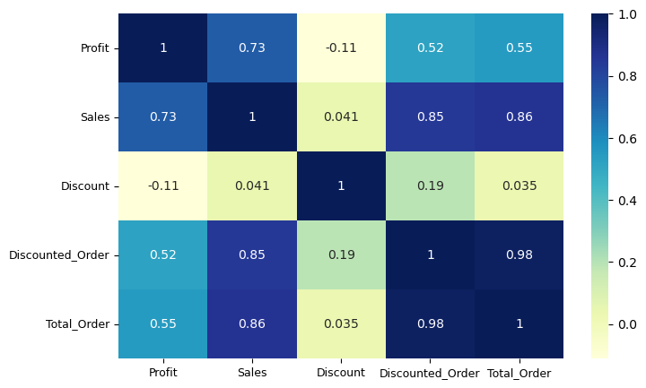
ORDERS FACTORS CORRELATION HEATMAP
The correlation between Discount and Profit is weak negative correlation
The correlation between Discounted_Order and Sales is positive correlation

Slide 24
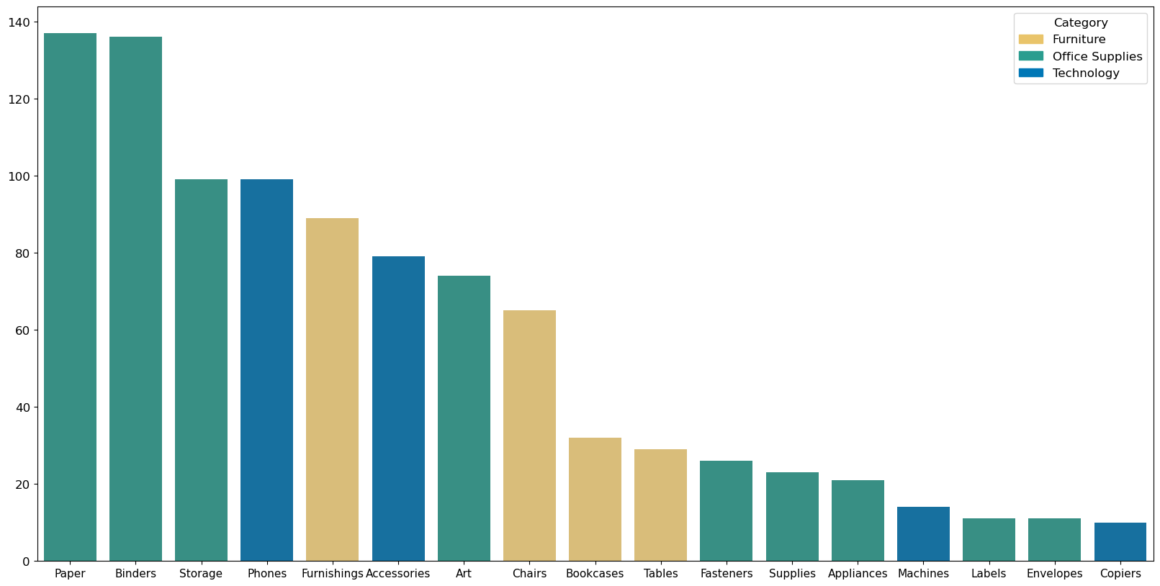
NUMBER OF PRODUCTS PURCHASED WITH ENVELOPES & LABELS

Slide 25
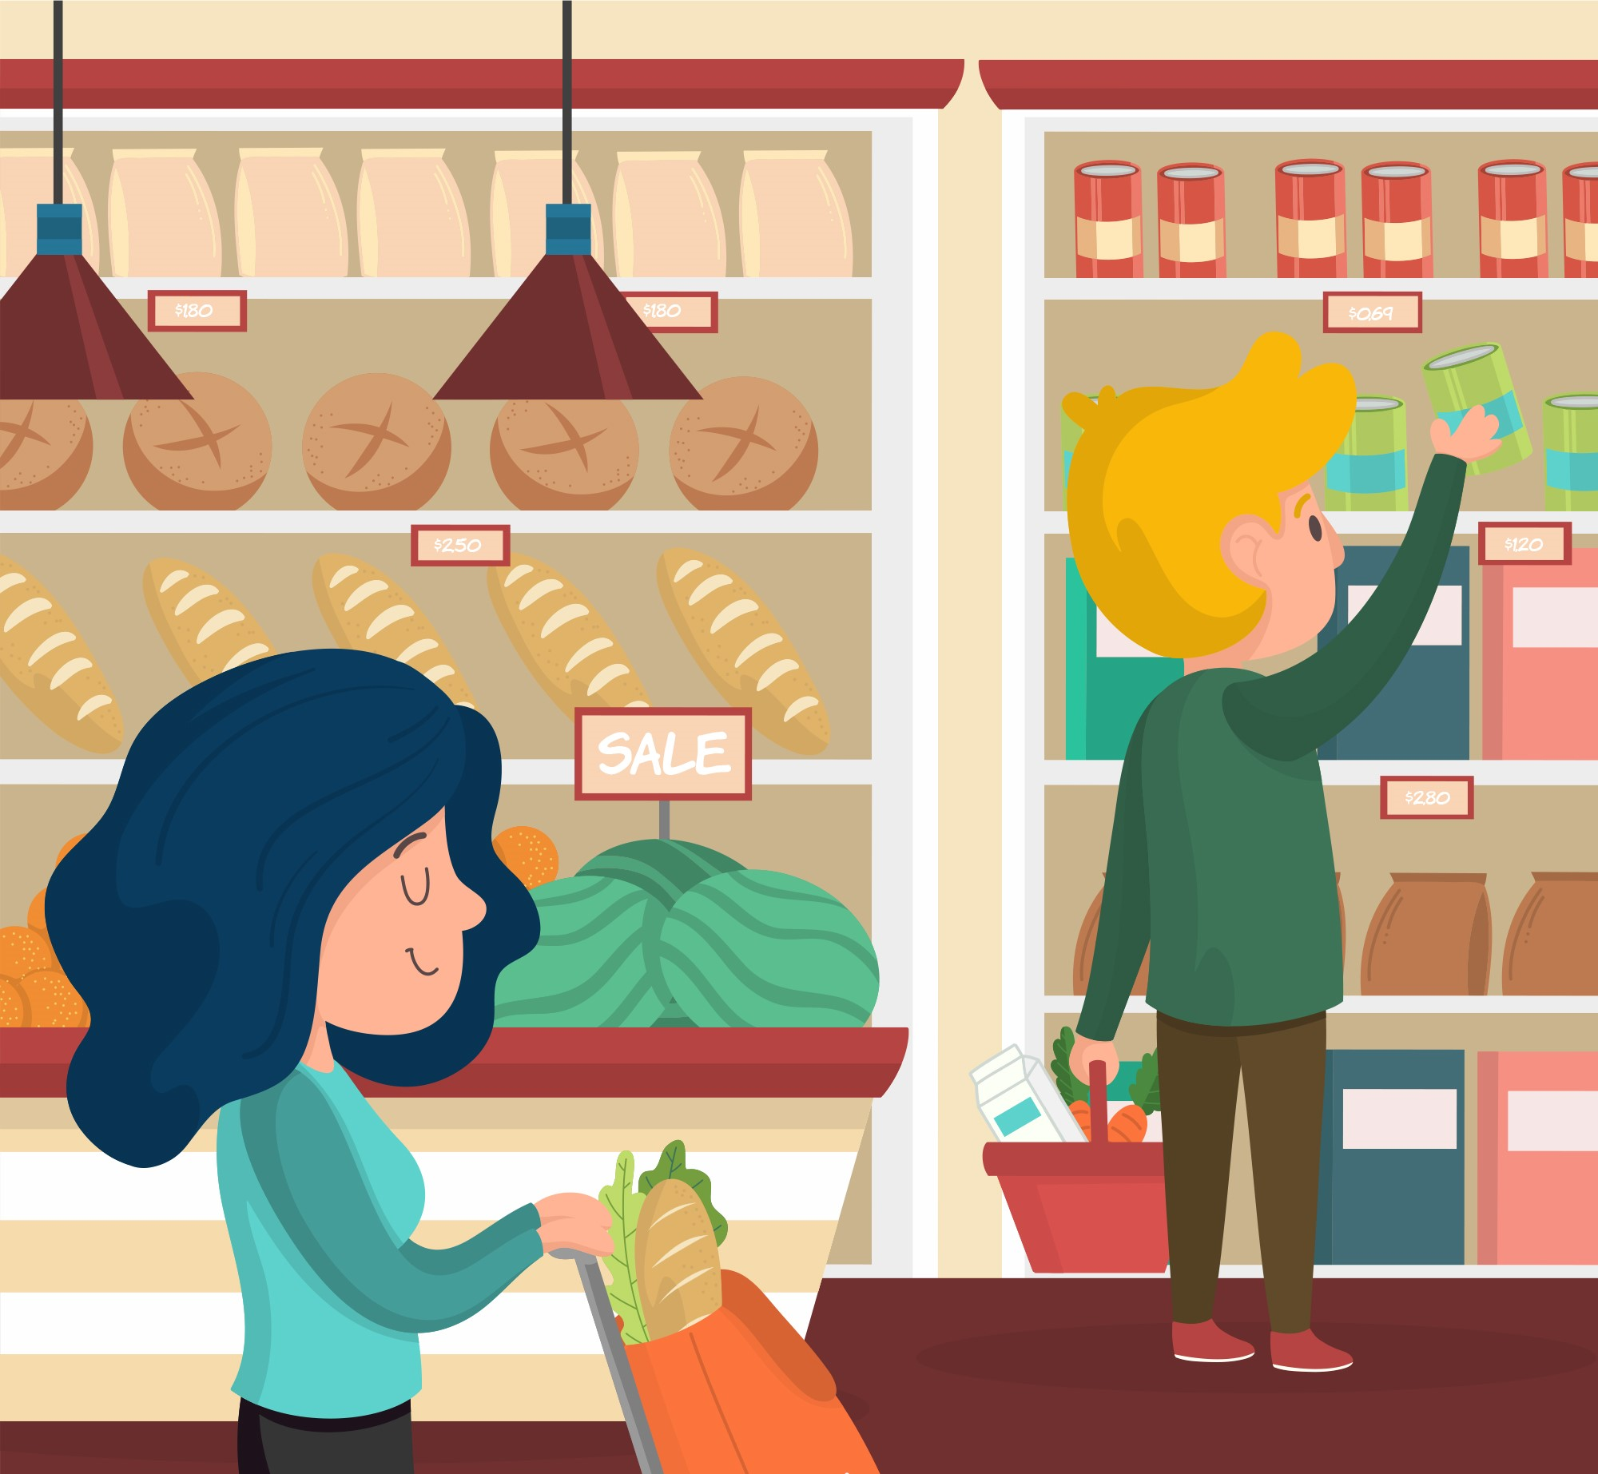
Arrange related products close together to increase the chance of customers buying more => This maybe increase sales
If customers buy on the app => recommend them to buy related products or products that other people often buy when buying this product

Slide 26

LOW SALES, HIGH PROFIT
The two products in Office Supplies are Envelopes and Labels, have low sales, but profits are quite high.
RECOMMENDATION:
Superstore should arrange shelves close to each other and suggest related products on the app.
Superstore should offer more discounts for orders => this will increase sales

Slide 27
NEW AND EXISTING CUSTOMERS

Slide 28
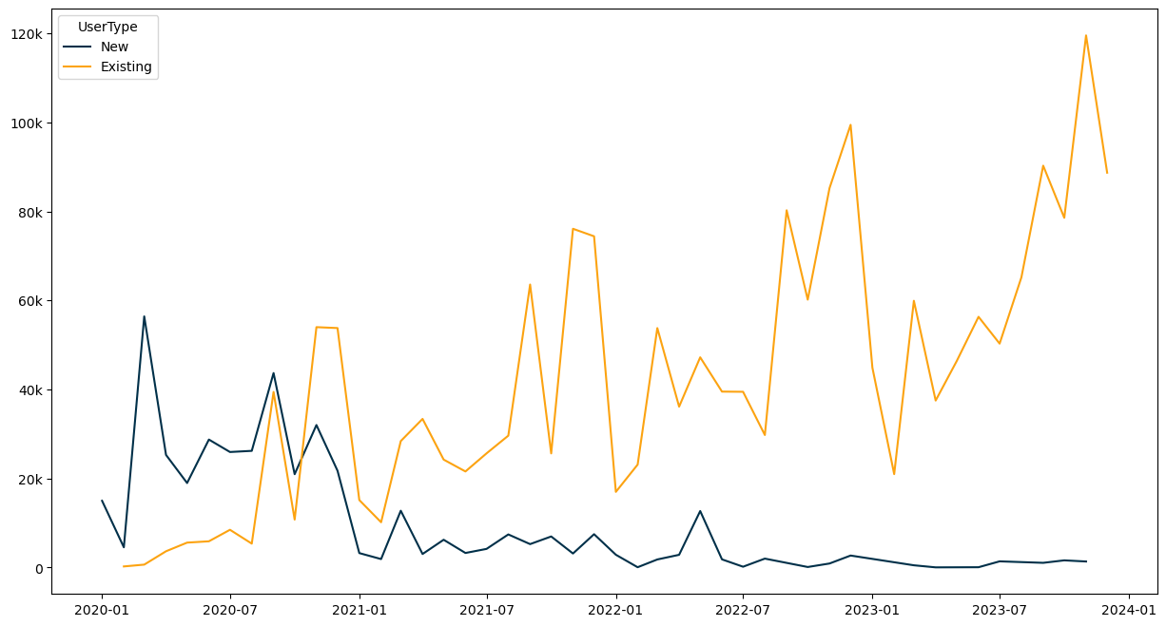
SALES BY NEW AND EXISTING CUSTOMER BY MONTH
By looking at the increased sales over time, the superstore has won the hearts of existing customer , but the opposite is true for new customers

Slide 29
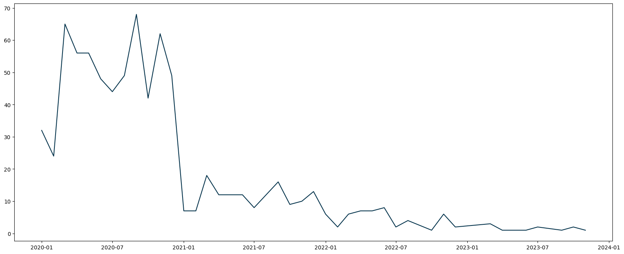
NEW CUSTOMER BY MONTH

Slide 30
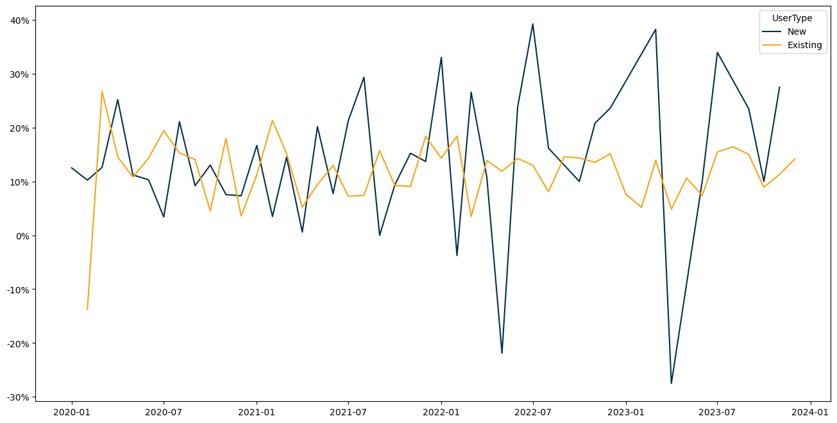
PROFIT RATE OF NEW AND EXISTING CUSTOMER BY MONTH
New customers have potential and present fluctuations in profit.
Attracting new customers can bring high profit.

Slide 31

Should the superstore attracts new customers while old customers already bring stable sales ?
Every returning customer the superstore have, was once a new customer.
New customers give the superstore key insights into what it can improve on to attract even more new customers.
New customers often replace old customers who have moved on from buying.
New customers are critical for ensuring business growth.
Source: https://graphite-note.com/new-vs-returning-customers-whos-more-important-in-e-commerce-retail/

Slide 32
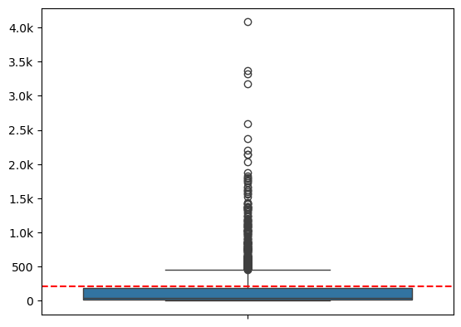
PRICE DISTRIBUTION OF NEW CUSTOMER
New customers often buy low-value products
mean price

Slide 33
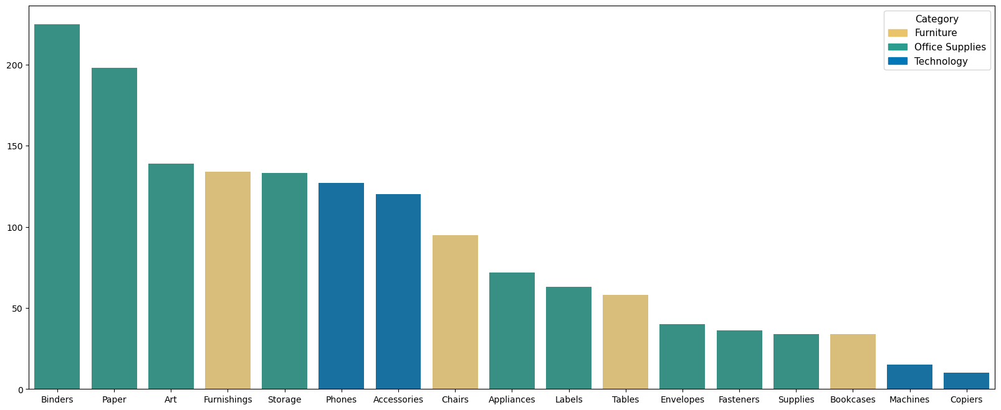
NUMBER OF PRODUCTS NEW CUSTOMERS TYPICALLY PURCHASE

Slide 34

NEW AND EXISTING CUSTOMER
The number of new customers and sales from this customer gradually decreases over time
RECOMMENDATION:
Attract new customers with products they often buy
Offer many discounted orders with these products => Brings profits and sales from the new customer

Slide 35

CONCLUSION
Category with high sales, low profit is due to some specific products that are not favorable and not target the right customers.
Category with high profit, low sales is due to some products belongs to Office Supplies which is sold at cheap price.
Discounted_Orders has a strong correlation with Sales for category with low sales, high profit. Increasing Discounted_Orders will increase sales and profit. Discounts not much impact on sales and profit.
The number of new customers decrease over time and they often buy low-value products, profit from new customers can be very high.

Slide 36
RECOMMENDATION
The Superstore should arrange shelves close to each other and suggest related products on the app and offer more discounts for orders
The Superstore should change their customer segment to improve profit.
Attract new customers with products they often buy and offer many discounted orders with these products.
Create welcome email campaigns that educate your new customers about your business.

Slide 37

THANK YOU FOR
LISTENING
AND
WATCHING

